Slide 1


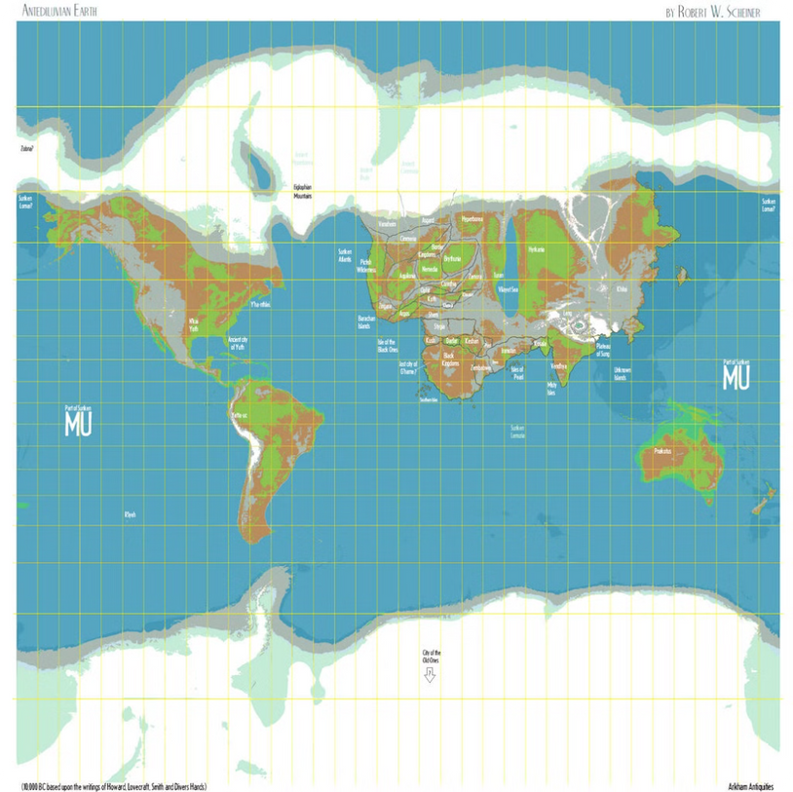


Global Cancer Incidence and Medical Investment: A Geospatial Analysis of Health Disparities and Resource Allocation
Cancer is a leading cause of death worldwide, affecting millions of people across all continents. Understanding the global distribution of cancer incidence and medical investment is crucial for effectively addressing this pressing public health challenge. This presentation explores the use of geospatial analysis to illuminate health disparities and inform resource allocation decisions.
Group BQ:
ONYEDIKACHI IKENNA ONWURAH MC467188
WONG CHON PAN MC464519
O
Notes:
1

Slide 2


Introduction: Importance of Understanding Global Cancer Trends and Medical Investment Patterns
1
Global Burden
2
Resource Allocation
Cancer is a significant public health burden, responsible for a substantial number of deaths worldwide. The incidence and mortality rates vary considerably across regions and countries.
Effective resource allocation is critical for improving cancer prevention, diagnosis, treatment, and palliative care. Understanding where resources are needed most is essential for maximizing impact.
3
Health Disparities
4
Geospatial Analysis
Health disparities often manifest in cancer outcomes, with certain populations experiencing higher incidence, mortality, and lower access to quality care.
Geospatial analysis provides a powerful tool for visualizing and analyzing cancer trends, medical investment patterns, and health disparities across geographic regions.
Notes:
2

Slide 3
Data Sources: IARC GLOBOCAN, World Bank, and Natural Earth
IARC GLOBOCAN
World Bank
Natural Earth
The International Agency for Research on Cancer (IARC) GLOBOCAN database provides comprehensive global cancer incidence and mortality data, including age-standardized rates and estimates for specific cancer types.
The World Bank collects and publishes data on healthcare expenditure, including medical investment for cancer prevention, diagnosis, and treatment, health status across countries.
Natural Earth provides high-quality geospatial data, including administrative boundaries, physical features, and population density, essential for mapping and visualization.
Notes:
3

Slide 4
Methodology: Geospatial Analysis Using GIS Tools, Including GeoPandas
Geospatial analysis involves using Geographic Information System (GIS) tools to analyze and interpret geographic data. GeoPandas is a powerful Python library that integrates with the Pandas data analysis library, enabling efficient manipulation and analysis of geospatial data.
Data Acquisition
Geospatial Analysis
Ai model prediction
Downloading and importing cancer incidence data from IARC GLOBOCAN, medical investment data from the World Bank, and geographic data from Natural Earth.
Using GeoPandas to perform spatial joins, create thematic maps, and analyze spatial relationships between cancer incidence, medical investment, and geographic factors.
Use the dataset to train on ai model to make a health status prediction base on available datas.
1
2
3
4
5
Data Processing
Visualization
Cleaning and formatting the data, including handling missing values and converting data formats to ensure compatibility.
Generating maps, charts, and graphs to visually represent and communicate insights from the analysis.
Notes:
4

Slide 5
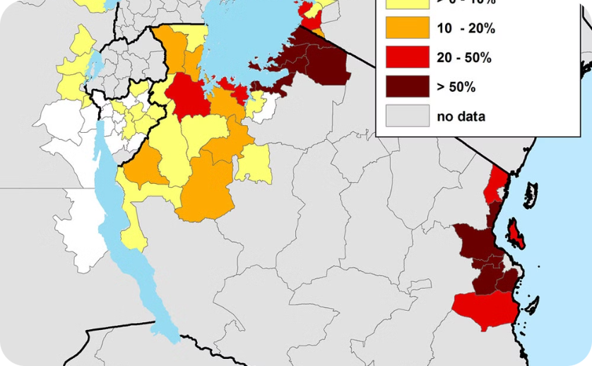
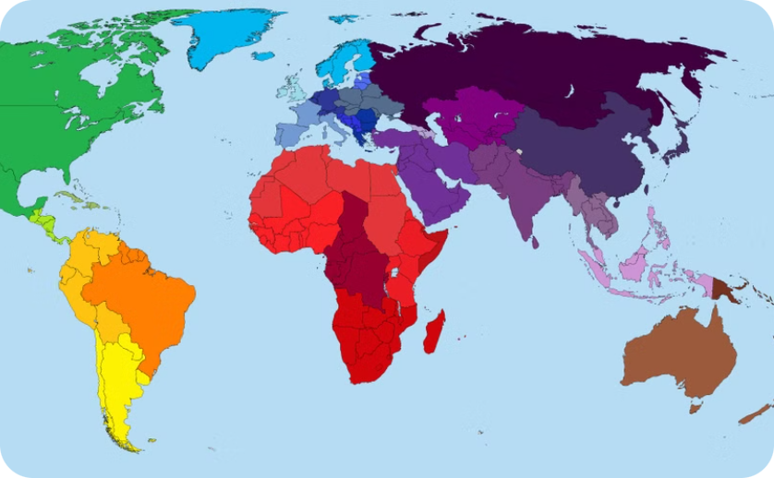
Mapping Global Cancer Incidence: Visualizing Geographic Variations
Global Cancer Incidence Map
National Cancer Incidence Maps
Visualizing global cancer incidence patterns using a choropleth map, where regions are shaded based on their age-standardized cancer rates.
Creating maps for individual countries to showcase regional variations in cancer incidence within specific nations.
Notes:
5

Slide 6
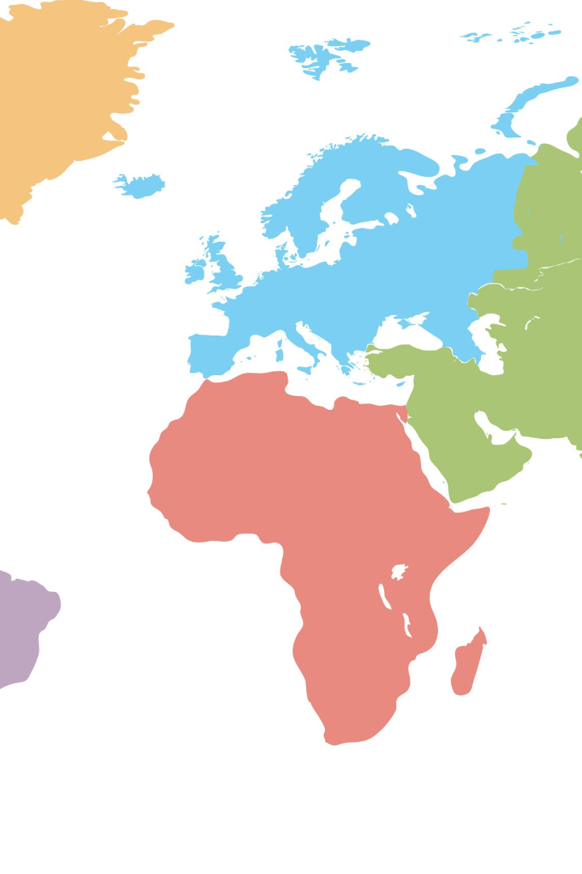
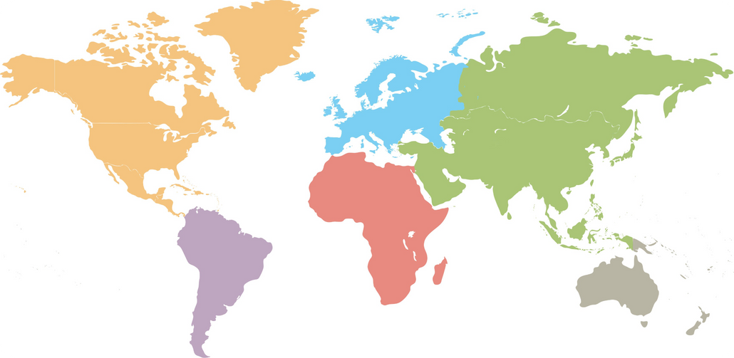
Analyzing Medical Investment: Patterns and Trends Across Regions
Region
Medical Investment per Capita (USD)
Cancer Incidence Rate (Age-Standardized)
North America
4,000
200 per 100,000
Europe
3,500
180 per 100,000
Latin America
1,500
150 per 100,000
Africa
500
120 per 100,000
Asia
1,000
160 per 100,000
Notes:
6

Slide 7

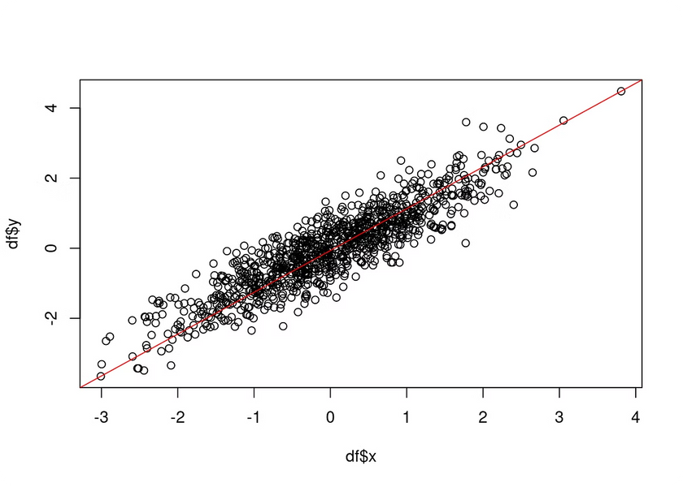



Identifying Health Disparities: Correlating Cancer Incidence and Medical Investment
Analyzing the correlation between cancer incidence rates and medical investment per capita across different regions using statistical methods and scatter plot visualization.
Spatial Clustering
Identifying geographic areas with high cancer incidence rates and low medical investment, indicating potential disparities in access to care.
Regression Analysis
Using statistical models to quantify the relationship between cancer incidence and medical investment, controlling for other factors such as population density and socioeconomic indicators.
Spatial Autocorrelation
Examining the spatial patterns of cancer incidence and medical investment to identify clusters and spatial dependencies, highlighting regional variations and potential drivers of disparities.
Notes:
7

Slide 8


Implications and Recommendations: Informing Policy and Resource Allocation Decisions
Targeted Interventions
Resource Allocation Optimization
Developing and implementing tailored interventions to address cancer disparities in specific geographic areas with high incidence and low medical investment.
Allocating resources to areas with the greatest need, based on evidence-based analysis of cancer incidence and medical investment patterns.
Policy Advocacy
Advocating for policies that promote equitable access to cancer prevention, diagnosis, treatment, and palliative care, particularly in underserved regions.
Notes:
8

Slide 9

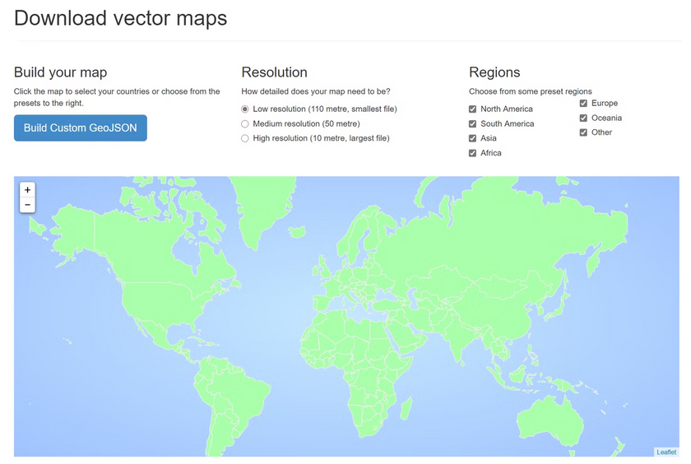



Conclusion: Leveraging Geospatial Analysis to Address Global Cancer Challenges
Geospatial analysis provides valuable insights into global cancer trends and medical investment patterns, highlighting health disparities and informing effective resource allocation. By integrating data sources, employing GIS tools, and visualizing spatial relationships, researchers and policymakers can better understand and address the global cancer burden.
Data-Driven Decisions
Geospatial analysis empowers evidence-based decision-making in cancer prevention, treatment, and resource allocation.
Promoting Health Equity
Addressing health disparities through targeted interventions and equitable access to quality cancer care.
Interdisciplinary Collaboration
Fostering partnerships among researchers, clinicians, policymakers, and communities to achieve impactful cancer control strategies.
Notes:
9

